Slide 1




Self Study
in
Microcontrollers
[15ES4GCMCS]
Akshit Bhalla
(1BM16EC015)
ARMv7 Architecture
Under the supervision
of
Dr. Suma M N
https://www.akshitbhalla.co
https://github.com/akshitbhalla
@akshitbhalla
Notes:
Refer to Jason Mayes' Machine Learning 101 slide deck for an in-depth introduction: https://docs.google.com/presentation/d/1kSuQyW5DTnkVaZEjGYCkfOxvzCqGEFzWBy4e9Uedd9k/

Slide 2
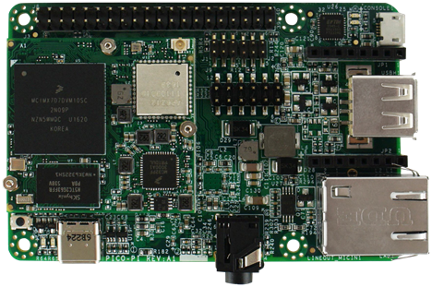
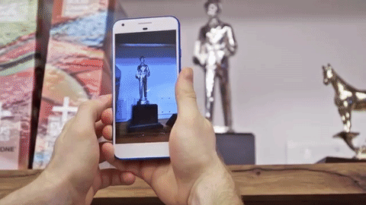
Pico i.MX7D
ARM Cortex – A7
1.2 GHz Clock Speed.
Modified Harvard Architecture.
Rich operating systems like Linux.
ARM Cortex – M4
32-bit processor, including address and data buses.
Fixed Memory Map.
Thumb-2 technology – 16 bit instructions
Akshit Bhalla MC (Dr. Suma M N) ARMv7 Architecture

Slide 4
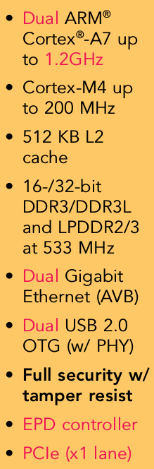
Comparison with 8051
Pico i.MX7D
Register Set
16 32-bit registers. None of the registers are directly addressable.
R13 is used as the Stack Pointer, R14 as the Link Register (for subroutine and exception return) and R15 as the Program Counter.
Stack
Full Descending stack (word-sized, 32 bits) addressed by the current stack pointer.
Akshit Bhalla MC (Dr. Suma M N) ARMv7 Architecture

Slide 5
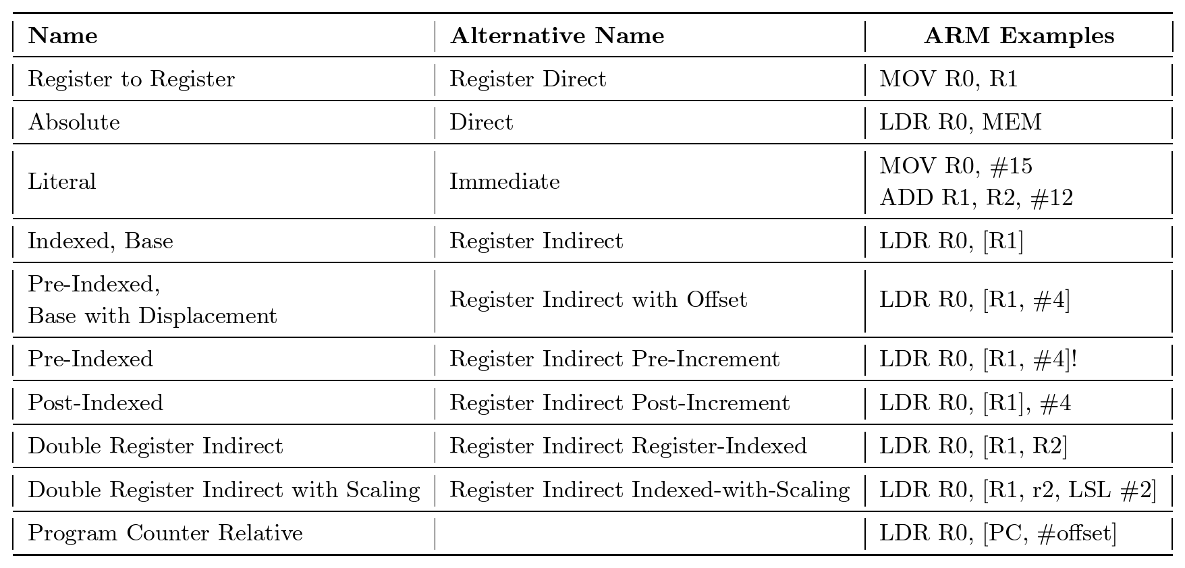
Comparison with 8051
Akshit Bhalla MC (Dr. Suma M N) ARMv7 Architecture

Slide 6
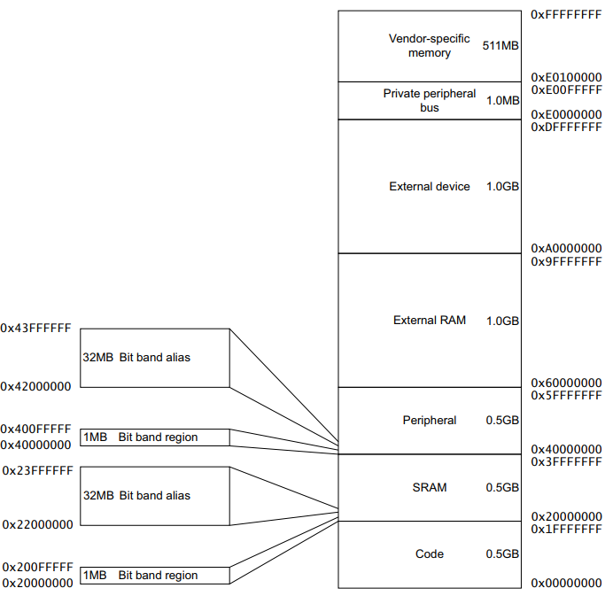
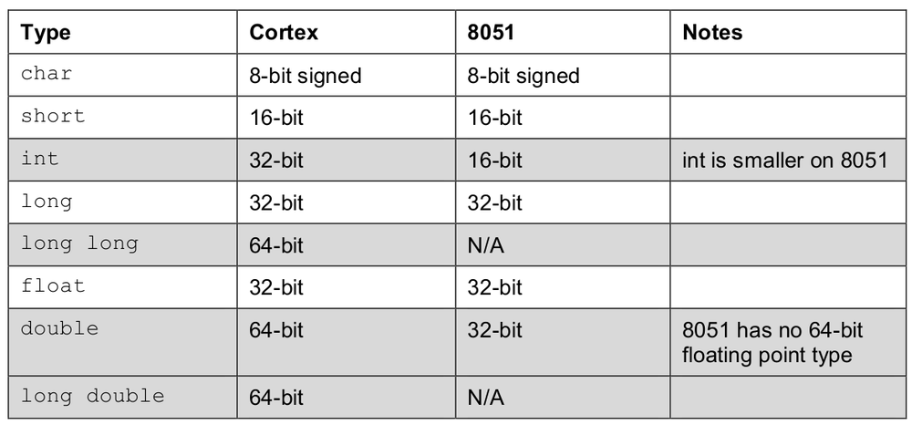
Comparison with 8051
Akshit Bhalla MC (Dr. Suma M N) ARMv7 Architecture

Slide 7

Implementation?
Akshit Bhalla MC (Dr. Suma M N) ARMv7 Architecture

Slide 8
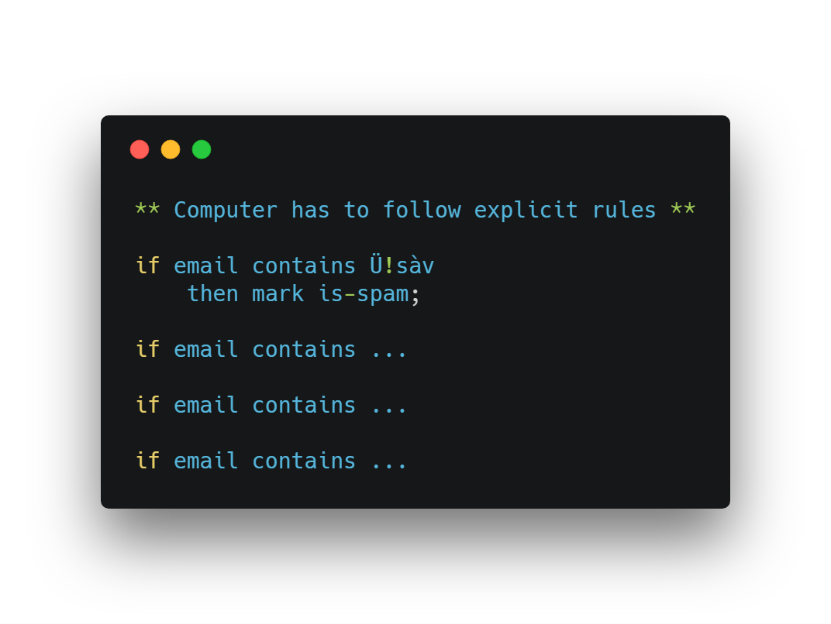
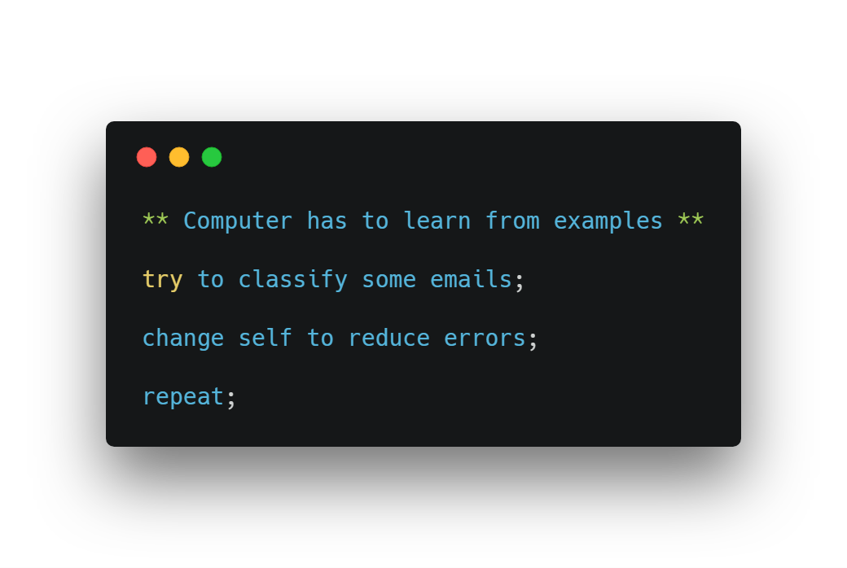
A different approach
Traditional Programming
Machine Learning
Akshit Bhalla MC (Dr. Suma M N) ARMv7 Architecture

Slide 9

Features / Attributes
Features are used to train an ML system.
They are the properties of the system we are trying to learn about.
Akshit Bhalla MC (Dr. Suma M N) ARMv7 Architecture
Notes:
https://www.instagram.com/wat.ki/ for more pictures of these two dogs and a hedgehog (and sometimes a cat).

Slide 10
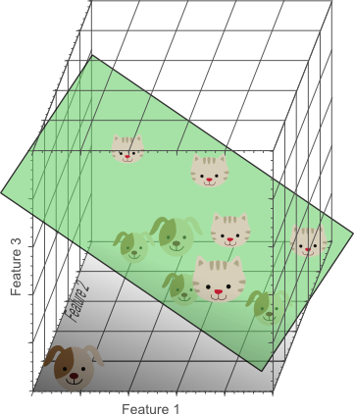
Non trivial data
Adding more dimensions to our dataset can help separate out the data points.
Too many dimensions however can lead to overfitting. The model will know the example data perfectly, but when given an object it has not seen before, it may fail to generalise well enough to recognise new things correctly.
Akshit Bhalla MC (Dr. Suma M N) ARMv7 Architecture

Slide 11
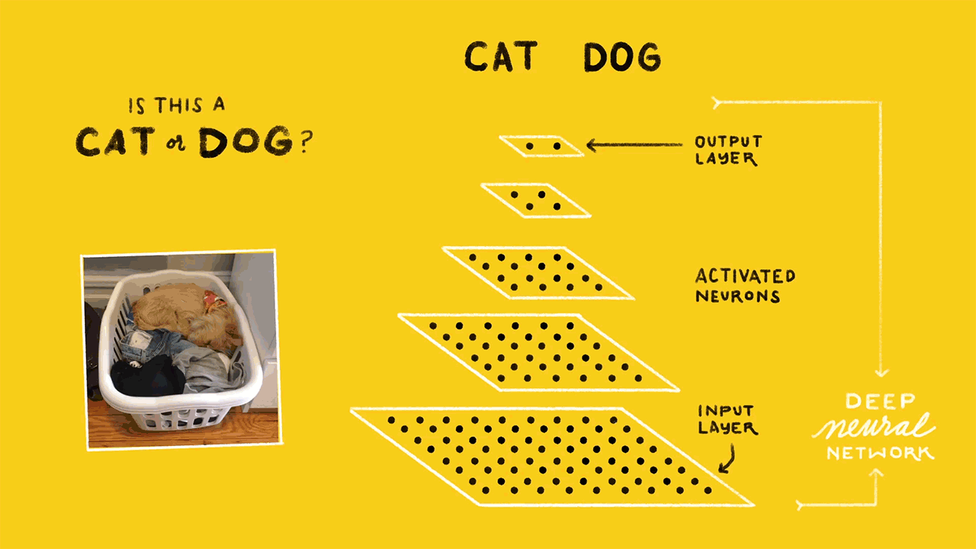

Slide 12
Reinforcement Learning
Akshit Bhalla MC (Dr. Suma M N) ARMv7 Architecture
Notes:
Learning through trial and error through reward or punishment

Slide 13
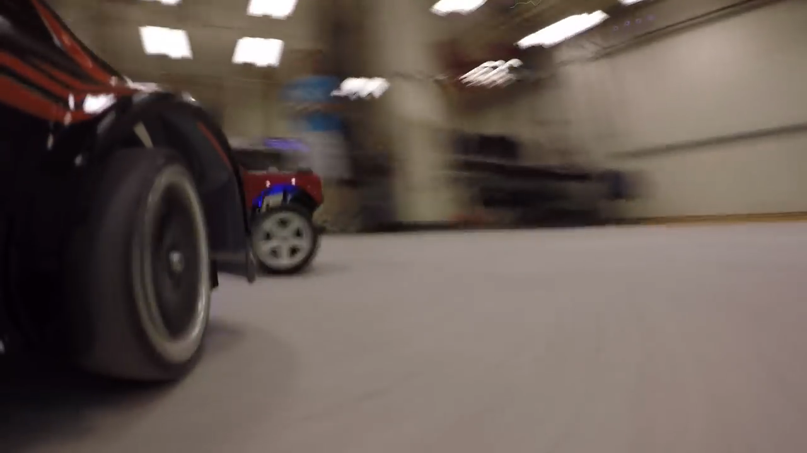
Notes:
Credit: MIT

Slide 14

Data Acquisition
Once important features have been identified, the biggest challenge is finding enough unbiased training data for those features in a format that can be fed into a ML system to learn from.
Akshit Bhalla MC (Dr. Suma M N) ARMv7 Architecture
Notes:
Combining 2 images such that you retain features from one and style from the other.
How?
1. Deep Neural Networks typically have many layers when trying to classify something. The lower layers typically are very simple eg edge detection, lines and shapes (style)
2. As you go higher up, the higher layers tend to recognize objects eg faces, hands, eyes etc (features)
3. If you take the features of the photo and combine with the style of the artwork, you can thus produce a stylized image as shown on the right.

Slide 15
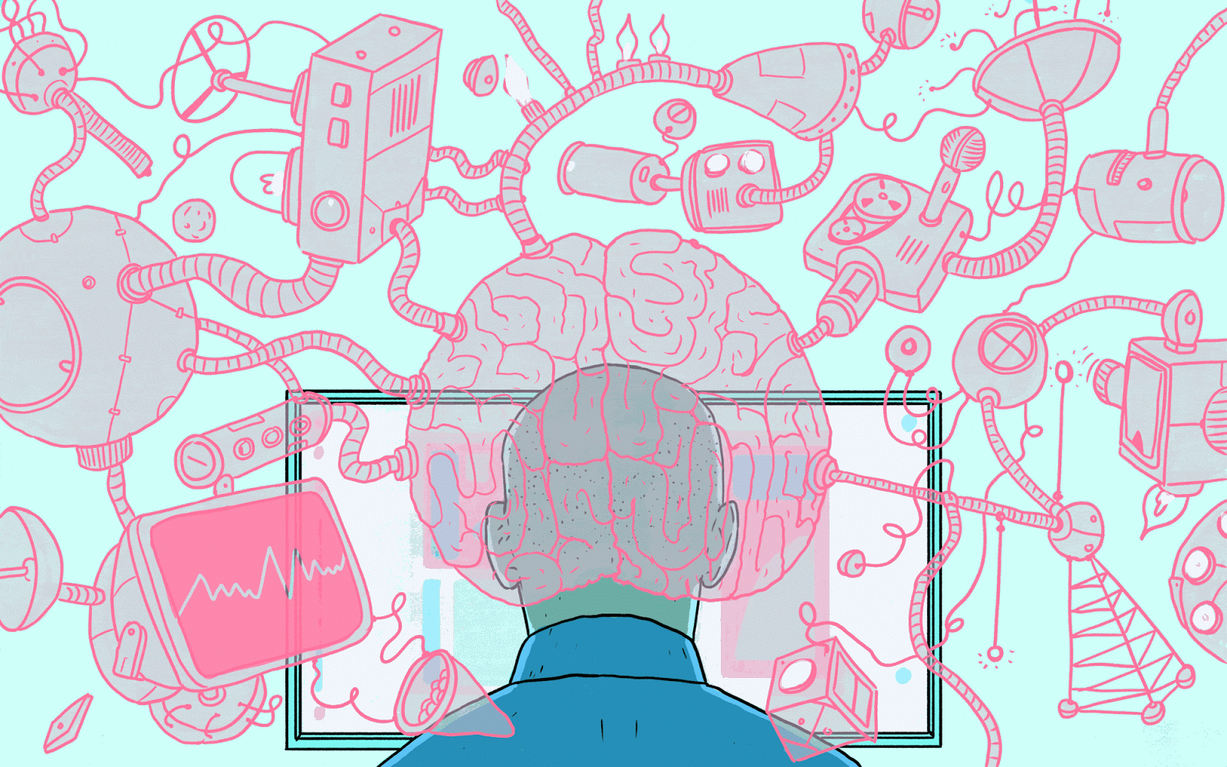
THANK YOU
Notes:
Combining 2 images such that you retain features from one and style from the other.
How?
1. Deep Neural Networks typically have many layers when trying to classify something. The lower layers typically are very simple eg edge detection, lines and shapes (style)
2. As you go higher up, the higher layers tend to recognize objects eg faces, hands, eyes etc (features)
3. If you take the features of the photo and combine with the style of the artwork, you can thus produce a stylized image as shown on the right.

